Slide 1
CHE 391
T. F. Edgar
Spring 2012

Slide 2
Response of Linear system
$\dot{x}=Ax$ $(u=0 or u=−Kx, Feedback Control)$
$x\left(t_{0}\right)=x_{0}$
Solution:
$x\left(t\right)$=$e^{A\left(t−t_{0}\right)}x\left(t_{0}\right)$
$e^{A\left(t−t_{0}\right)}≜Φ\left(t, t_{0}\right)$ ( Transition Matrix)
Usually $t_{0}=0$
$Φ\left(t, t_{0}\right)=$ $e^{At}=I+At+A∙At^{2}+…$
Computationally not feasible for general use→ need analytical solution

Slide 3
Take Laplace Transform:
$$sX\left(s\right)−x\left(0\right)=AX\left(s\right)$$
$$\left(sI−A\right)X\left(s\right)=x\left(0\right)$$
$$X\left(s\right)={\left(sI−A\right)}^{−1}x\left(0\right)$$
Take inverse Laplace Transform
$$x\left(t\right)=ℒ^{−1}\left[{\left(sI−A\right)}^{−1}\right]x\left(0\right)$$
As $x\left(t\right)=Φ\left(t\right)x\left(0\right)$
$$e^{At}=ℒ^{−1}\left[{\left(sI−A\right)}^{−1}\right]$$
(note scalar analog: $e^{at}\overset{⇔}{}\frac{1}{s−a}$)

Slide 4
Example
$$A= \left[\begin{matrix} 0 & 1 \\ −2 & −3\end{matrix}\right]$$
$\left(sI−A\right)$= $\left[\begin{matrix} s & −1 \\ −2 & s+3\end{matrix}\right]$
${\left(sI−A\right)}^{−1}=$ $\left[\begin{matrix}\frac{s+3}{s^{2}+3s+2} & \frac{1}{D} \\ \frac{−2}{D} & \frac{s}{D}\end{matrix}\right]$ (Here, $D=\left(s+2\right)\left(s+1\right)$)
Invert, partial fraction decomposition
$$Φ\left(t\right)=\left[\begin{matrix}2e^{−t}−e^{−2t} & e^{−t}−e^{−2t} \\ −2e^{−t}+2e^{−2t} & −e^{−t}+{2e}^{−2t}\end{matrix}\right]$$

Slide 5
Note that $Φ\left(0\right)=I$
Also, denominator of $Φ\left(s\right)$ is $det\left(sI−A\right)$
Roots of $D$ are the same as the factors of characteristic equation$≡$eigenvalues($p_{i}$) of $A$
Eigenvalue Equation:
$det\left(A−pI\right)=\det\left(pI−A\right)=0$

Slide 6
Eigenvector/eigenvalue solution
Example: 2nd order
$$x\left(t\right)=c_{1}v^{1}e^{p_{1}t}+c_{2}v^{2}e^{p_{2}t}$$
$$\dot{x}\left(t\right)={p_{1}c}_{1}v^{1}e^{p_{1}t}+{p_{2}c}_{2}v^{2}e^{p_{2}t}=Ax$$
$$=A\left[c_{1}v^{1}e^{p_{1}t}+c_{2}v^{2}e^{p_{2}t}\right]$$
Equating $e^{p_{i}t}$ terms:
$${p_{1}v}^{1}={Av}^{1}$$
$${p_{2}v}^{2}={Av}^{2}$$
If $p_{i}$, $v^{i}$ satisfy eigenvalue, eigenvector equations
For nth order model, $A_{n×n}$

Slide 7
$$A∙\left[\begin{matrix}v^{1} & ⋯ & v^{n} \\ ⋮ & ⋱ & ⋮ \\ . & ⋯ & .\end{matrix}\right]=\left[\begin{matrix}{p_{1}v}^{1} & ⋯ & {p_{n}v}^{n} \\ ⋮ & ⋱ & ⋮ \\ . & ⋯ & .\end{matrix}\right]$$
Define $V$= matrix of eigenvectors
(also called similarity transform, modal matrix, eigenvector assembly matrix)
$$Λ=\left[\begin{matrix}p_{1} & 0 & … & 0 \\ 0 & p_{2} & 0 & 0 \\ ⋮ & 0 & ⋱ & ⋮ \\ 0 & ⋯ & 0 & p_{n}\end{matrix}\right]$$
$AV=VΛ$➔ $\left.\begin{aligned}A=VΛV^{−1} \\ or Λ=V^{−1}AV\end{aligned}\right\}$ Relates $A$, $V$, and $Λ$

Slide 8
Example
$A=\left[\begin{matrix}−8 & 2 \\ 7 & −3\end{matrix}\right]$
$p_{1}=−1$, $p_{2}=−10$, $v^{1}=\left[\begin{matrix}2 \\ 7\end{matrix}\right]$, $v^{2}=\left[\begin{matrix} 1 \\ −1\end{matrix}\right]$
$x\left(t\right)=\left[\begin{matrix}2 \\ 7\end{matrix}\right]\text{∙}c_{1}e^{−t}+\left[\begin{matrix} 1 \\ −1\end{matrix}\right]\text{∙}c_{2}e^{−10t}$
Note that $v^{1}$, $v^{2}$ must be linearly independent
(at $t=0$, solve for $c_{1}$, $c_{2}$)
For $x\left(0\right)=\left[\begin{matrix}10 \\ 0\end{matrix}\right]$, we have $c_{1}=1.11$, $c_{2}=7.78$
Then, $x\left(t\right)=\left[\begin{matrix}2.22 \\ 7.78\end{matrix}\right]\text{∙}c_{1}e^{−t}+\left[\begin{matrix} 7.78 \\ −7.78\end{matrix}\right]\text{∙}c_{2}e^{−10t}$
Note that when $t$ is very large, neglect the 2nd term.
$$x\left(t\right)=c\left(t\right)v^{1}$$

Slide 9
If $A$ is in canonical form,
$A=\left[\begin{matrix}0 & & & \\ 0 & & I_{n−1×n−1} & \\ ⋮ & & & \\ −a_{0} & −a_{1} & ⋯ & −a_{n−1}\end{matrix}\right]$
$V=\left[\begin{matrix}1 & 1 & ⋯ & 1 \\ p_{1} & p_{2} & ⋯ & p_{n} \\ p_{1}^{2} & p_{2}^{2} & & p_{n}^{2} \\ ⋮ & ⋮ & ⋱ & ⋮ \\ p_{1}^{n−1} & p_{2}^{n−1} & ⋯ & p_{n}^{n−1}\end{matrix}\right]$ (Vandermonde Matrix)
Note, if $p_{i}$ is complex, $v_{i}$ is complex.

Slide 10
Another way to calculate $Φ\left(t\right)$using $V$, $Λ$
$\dot{x}=Ax$, let $x=Vz$ (transformation), then we have
$V\dot{z}=AVz$ ➔ $\dot{z}=V^{−1}AVz=Λz$
The solution for the ODE is $z\left(t\right)=e^{Λt}z\left(0\right)$
Where $e^{Λt}=\left[\begin{matrix}e^{p_{1}t} & & & 0 \\ & e^{p_{2}t} & & \\ & & ⋱ & \\ 0 & & & e^{p_{n}t}\end{matrix}\right]$ (a diagonal matrix)
hence $z_{i}\left(t\right)=e^{p_{i}t}z_{i}\left(0\right)$ (“modes” of the system)
The analytical solution to $\dot{x}=Ax$ is therefore
$x=Vz=Ve^{Λt}z\left(0\right)$ $z\left(0\right)=V^{−1}x\left(0\right)$
$x\left(t\right)=Ve^{Λt}V^{−1}x\left(0\right)$ and $Φ\left(t\right)=Ve^{Λt}V^{−1}$
If $p_{i}$ are complex or repeated, modify the above procedure. (see Ogata)

Slide 11
Add controller
$$\dot{x}=Ax+Bu$$
Substitute $x=Vz$ , we have $V\dot{z}=AVz+Bu$
$$\dot{z}=V^{−1}AVz+V^{−1}Bu=Λz+V^{−1}Bu$$
Let $u=−Kz$ (Modal feedback. $u=−KV^{−1}x$)
$$\dot{z}=\left(Λ−V^{−1}BK\right)z$$
Multivariable root locus
(some limitations in MIMO as in SISO – closed-loop response depends on eigenvectors as well as eigenvalues.)
Shifts eigenvalues

Slide 12
“Autonomous” model $\dot{x}=Ax+Bu$
$A$, $B$ not functions of $t$; $x$, $u$ deviation variables . Take L.T.,
$$\left(sI−A\right)X\left(s\right)=BU\left(s\right)$$
$$X\left(s\right)={\left(sI−A\right)}^{−1}BU\left(s\right)$$
If $Y\left(s\right)=CX\left(s\right)$ ($y=Cx$ )
(output states or controlled variables)
Then the output is
$$Y\left(s\right)=C{\left(sI−A\right)}^{−1}BU\left(s\right)$$
Transfer function matrix $G_{p}\left(s\right)$

Slide 13
Example:
$x\left(t\right)=c_{1}v^{1}e^{p_{1}t}+c_{2}v^{2}e^{p_{2}t}$
$p_{1}=−1$, $p_{2}=−10$
Shift pole $p_{1}$ to higher value
However, if $x\left(0\right)$ is such that $c_{1}=0$, shifting $p_{1}$has no effect on response

Slide 14
Stability Requirements
Continuous: all $Re\left(p_{i}\right)≤0$
Discrete: $x_{k+1}=Fx_{k}+Gu_{k}$
$p_{i}$ eigenvalues of $F$, $\left|p_{i}\right|≤1$
(for complex $p_{i}$, all $p_{i}$ must lie within unit circle)

Slide 15
Analytical Solution:
$\dot{x}−Ax=Bu$ $x\left(t_{0}\right)=x_{0}$
Pre-multiply by ${exp\left(−At\right)=e}^{−At}$ (integrating factor)
$exp\left(−At\right)\dot{x}−exp\left(−At\right)Ax=exp\left(−At\right)Bu$ ➔ $\frac{d}{dt}\left(exp\left(−At\right)x\right)=exp\left(−At\right)Bu$
Integrating between $t_{0}$ and $t_{1}$:
$$exp\left(−At_{1}\right)x_{1}−exp\left(−At_{0}\right)x_{0}=\int_{t_{0}}^{t_{1}}{exp\left(−At\right)Budt}$$
$$x\left(t_{1}\right)=x_{1}=exp\left[A\left(t_{1}−t_{0}\right)\right]x_{0}+\int_{t_{0}}^{t_{1}}{exp\left[A\left(t_{1}−t\right)\right]Bu\left(t\right)dt}$$
Homogenous Solution, $Φ\left(t_{1}−t_{0}\right)$
Particular Solution

Slide 16
If $x_{0}=0$ ➔ convolution integral
Note that $x\left(t_{1}\right)$ depends only on $t_{1}−t_{0}=∆t$. Let $t_{0}=0$
$$x\left(∆t\right)=Φ\left(∆t\right)x\left(0\right)+\int_{0}^{∆t}{Φ\left(∆t−λ\right)Bu\left(λ\right)dλ}$$
Sampled data system: $u\left(λ\right)=u\left(0\right)$ ($0≤t≤∆t$)
Define $G=\int_{0}^{∆t}{Φ\left(∆t−λ\right)Bdλ}$
$x\left(∆t\right)=Fx\left(0\right)+Gu\left(0\right)$ ($F$, $G$ are functions of $∆t$ only )
Generalize to any time step $k$ ➔ $x_{k+1}=Fx_{k}+Gu_{k}$
Calculation of $F$, $G$ : use infinite series expression
$$F=I+A∆t+A∙A∙\frac{{∆t}^{2}}{2}+…$$

Slide 17
$G=Φ\left(∆t\right)\int_{0}^{∆t}{Φ\left(−λ\right)dλ∙B}$
Where $\int_{0}^{∆t}{Φ\left(−λ\right)dλ}=\int_{0}^{∆t}{e^{−Aλ}dλ}=A^{−1}\left[I−e^{−A∆t}\right]=A^{−1}\left[I−\left[I−A∆t+A∙A∙\frac{{∆t}^{2}}{2}−…\right]\right]=I∆t−A∙\frac{{∆t}^{2}}{2}+…$
Use finite number of terms
$$x\left(k+2\right)=Fx\left(k+1\right)+Gu\left(k+1\right)$$
$$=F^{2}x\left(k\right)+FGu\left(k\right)+Gu\left(k+1\right)$$
$$x\left(k+p\right)=F^{p}x\left(k\right)+\sum_{i=0}^{p−1}{F^{p−1−i}}Gu\left(k+i\right)$$
No integration error for sampled data control (zero-order hold)

Slide 18
Discrete-time State Controllability
$$x\left(n\right)−F^{n}x\left(0\right)=F^{n−1}Gu\left(0\right)+F^{n−2}Gu\left(1\right)+…+Gu\left(n−1\right)$$
$n$ is the order of the system.
We need to be able to generate any $x\left(n\right)$ from $x\left(0\right)$ using $u\left(0\right)$, $u\left(1\right)$, etc.
Example: $u$ is a scalar, $F_{n×n}$, $G_{n×1}$, $F^{k}G$ is $n×1$
$n$ equations, and $n$ unknowns
(rank must be n, determinant ≠ 0. No rows, columns are linearly dependent.)
Use Gaussian elimination to check controllability

Slide 19
Example:
${\dot{x}}_{1}=x_{2}+u$
${\dot{x}}_{2}={{−x}_{1}−2x}_{2}−u$
$A=\left[\begin{matrix} 0 & 1 \\ −1 & −2\end{matrix}\right]$, $B=\left[\begin{matrix} 1 \\ −1\end{matrix}\right]$
$M=\left[B|AB\right]=\left[\begin{matrix} 1 & −1 \\ −1 & 1\end{matrix}\right]$ (not linear independent)
Controllability Matrix:
Discrete-time:
$$M_{D}=\left[G\left|FG\right|F^{2}G|…|F^{n−1}G\right]$$
Continuous-time:
$$M_{C}=\left[B\left|AB\right|A^{2}B|…|A^{n−1}B\right]$$

Slide 20
Observability
$\left\{\begin{aligned}x\left(k+1\right)=Fx\left(k\right) \\ y=Hx\end{aligned}\right.$
$y\left(0\right)=Hx\left(0\right)$, $y\left(2\right)=HF^{2}x\left(0\right)$, $y\left(n−1\right)=HF^{n−1}x\left(0\right)$
Example:
Suppose $x\left(0\right)$ is $n×1$ (unknown vector), $y$ is $1×1$ (scalar)
After $\left(n−1\right)$ time steps, can we reconstruct $x\left(0\right)$ using $n$ values of $y$ ($y\left(0\right)$, $y\left(1\right)$, …, $y\left(n−1\right)$)?
In this case $H$ is $1×n$
$$\left[\begin{matrix}y\left(0\right) \\ y\left(1\right) \\ ⋮ \\ y\left(n−1\right)\end{matrix}\right]=\left[\begin{matrix}H \\ HF \\ ⋮ \\ HF^{n−1}\end{matrix}\right]x\left(0\right)$$
$n$ equations, $n$ unknowns
Must have rank $n$

Slide 21
Observability Matrix
Discrete:
$$N_{D}=\left[H^{T}\left|F^{T}H^{T}\right|…|{\left(F^{T}\right)}^{n−1}H^{T}\right]$$
must have rank $n$
Continuous:
$\dot{x}=Ax$, $y=Cx$
$$N_{C}=\left[C^{T}\left|A^{T}C^{T}\right|…|{\left(A^{T}\right)}^{n−1}C^{T}\right]$$
must have rank $n$

Slide 22
Example
$A\underset{→}{k_{1}}B$
$A+C\underset{→}{k_{2}}D$
$B+C\underset{→}{k_{3}}Unknown Compounds (not B, C, or D)$
Linearize Equations -> deviation variables
$$\frac{dC_{A}}{dt}=−k_{1}C_{A}−k_{2}C_{A}C_{C}$$
$$\frac{dC_{B}}{dt}=k_{1}C_{A}−k_{3}C_{B}C_{C}$$
$$\frac{dC_{C}}{dt}=−k_{2}C_{A}C_{C}−k_{3}C_{B}C_{C}$$
$$\frac{dC_{D}}{dt}=k_{2}C_{A}C_{C}$$
$$\dot{x}=Ax$$
$$x=\left[\begin{matrix}C_{A}−C_{A_{s}} \\ C_{B}−C_{B_{s}} \\ C_{C}−C_{C_{s}} \\ C_{D}−C_{D_{s}}\end{matrix}\right]$$

Slide 23
$$A=\left[\begin{matrix}α_{11} & 0 & α_{13} & 0 \\ α_{21} & α_{22} & α_{23} & 0 \\ α_{31} & α_{32} & α_{33} & 0 \\ α_{41} & 0 & α_{43} & 0\end{matrix}\right]$$
Case 1: Measure A, C, D ($y=Cx$)
$$C=\left[\begin{matrix}1 & 0 & 0 & 0 \\ 0 & 0 & 0 & 0 \\ 0 & 0 & 1 & 0 \\ 0 & 0 & 0 & 1\end{matrix}\right]$$
$$N_{C}=\left[C^{T}|A^{T}C^{T}\right]=\left[\begin{matrix}1 & 0 & 0 & 0 & ∗ & 0 & ∗ & ∗ \\ 0 & 0 & 0 & 0 & 0 & 0 & ∗ & 0 \\ 0 & 0 & 1 & 0 & ∗ & 0 & ∗ & ∗ \\ 0 & 0 & 0 & 1 & 0 & 0 & 0 & 0\end{matrix}\right]$$
4 linear independent columns → Observable

Slide 24
Case 2, 3: Measure (A,B,D) , (B,C,D) ➔Observable
Case 4: Measure A, B, C ➔ Not observable
Physical interpretation: since D does not affect any other outputs (does not appear in any rate equations), we don’t know D(0) unless it is measured directly
Note: if adding ${\left(A^{T}\right)}^{j}C^{T}$ doesn’t increase the rank of the sequence $\left[C^{T}, A^{T}C^{T}, {\left(A^{T}\right)}^{2}C^{T}, …\right]$, you don’t need to check any further. (Same for controllability).

Slide 25
Other Controllability Considerations
Modal equation: $\dot{z}=Λz+V^{−1}Bu$
$V^{−1}B$ must not have a null row (must be able to control all modes)
(2) $adj\left(sI−A\right)$ must have no common factor with $det\left(sI−A\right)$
(3) For non-distinct eigenvalues, rules must be modified;
(4) Output controllability of system
$\dot{x}=Ax+Bu$ , $y=Cx+Du$ (usually $D=O$, $C_{m×n}$, $y_{m×1}$)
$rank\left[CB\left|CAB\right|CA^{2}B|…\right]=m$

Slide 26
MIMO Model Linearization
Nonlinear model: $\dot{z}=f\left(z,v\right)$
$z$: state variable ($n×1$)
$v$: decision variable ($r×1$)
Linearization→ define deviation variables:
$$x=z−z_{ss}$$
$$u=v−v_{ss}$$
(Requires iterative solution of $f\left(z_{ss},v_{ss}\right)=0$)

Slide 27
Use 1st order Taylor Series (invalid for large $x$, $u$)
Scalar case:
$$\dot{z}=\dot{x}=f\left(z_{ss},v_{ss}\right)+{\left.\frac{∂f}{∂z}\right|}_{ss}\left(z−z_{ss}\right)+{\left.\frac{∂f}{∂v}\right|}_{ss}\left(v−v_{ss}\right)={\left.\frac{∂f}{∂z}\right|}_{ss}\left(x\right)+{\left.\frac{∂f}{∂v}\right|}_{ss}\left(u\right)$$
Vector case:
$$\dot{x}=Ax+Bu$$
$$A_{n×n}=\left\{{\left.\frac{∂f_{i}}{∂z_{j}}\right|}_{ss}\right\} (Jacobian),B_{n×r}=\left\{{\left.\frac{∂f_{i}}{∂v_{j}}\right|}_{ss}\right\}$$
Analytical vs. numerical

Slide 28
Minimal State Vector Representation (MIMO Systems)
$\dot{x}=Ax+Bu$ $x=Vz$ → $V\dot{z}=AVz+Bu$
$$\dot{z}=V^{−1}AVz+V^{−1}Bu=Λz+V^{−1}Bu$$
$$\left(sI−Λ\right)Z\left(s\right)=V^{−1}BU\left(s\right)$$
$Z\left(s\right)={\left(sI−Λ\right)}^{−1}V^{−1}BU\left(s\right)$, $V^{−1}X\left(s\right)=Z\left(s\right)$
$$V^{−1}X\left(s\right)={\left(sI−Λ\right)}^{−1}V^{−1}BU\left(s\right)$$
$$X\left(s\right)=V{\left(sI−Λ\right)}^{−1}V^{−1}BU\left(s\right)$$
$$Y\left(s\right)=CX\left(s\right)=CV{\left(sI−Λ\right)}^{−1}V^{−1}BU\left(s\right)$$
Make $CV=γ$, $V^{−1}B=E$, then the transfer function is
$$G_{p}\left(s\right)=CV{\left(sI−Λ\right)}^{−1}V^{−1}B=γ{\left(sI−Λ\right)}^{−1}E$$
Question:
Given $G_{p}\left(s\right)$, how do we find $\left(A, B, C\right)$ which gives a model of minimal order? (or given step response for all inputs/outputs)

Slide 29
Example: $2×2$ (Second order)
$$G_{p}\left(s\right)=\left[\begin{matrix}\frac{2s+11}{\left(s+4\right)\left(s+2\right)} & \frac{s+6}{\left(s+4\right)\left(s+2\right)} \\ \frac{s−5}{\left(s+4\right)\left(s+2\right)} & \frac{s−2}{\left(s+4\right)\left(s+2\right)}\end{matrix}\right]=γ{\left(sI−Λ\right)}^{−1}E=\left[\begin{matrix}γ_{11} & γ_{12} \\ γ_{21} & γ_{22}\end{matrix}\right]\left[\begin{matrix}\frac{1}{s−p_{1}} & 0 \\ 0 & \frac{1}{s−p_{2}}\end{matrix}\right]\left[\begin{matrix}E_{11} & E_{12} \\ E_{21} & E_{22}\end{matrix}\right]=\left[\begin{matrix}\frac{E_{11}γ_{11}}{s−p_{1}}+\frac{E_{21}γ_{12}}{s−p_{2}} & \frac{E_{12}γ_{11}}{s−p_{1}}+\frac{E_{22}γ_{12}}{s−p_{2}} \\ \frac{E_{11}γ_{21}}{s−p_{1}}+\frac{E_{21}γ_{22}}{s−p_{2}} & \frac{E_{12}γ_{21}}{s−p_{1}}+\frac{E_{22}γ_{22}}{s−p_{2}}\end{matrix}\right]$$
(2 poles => 2nd order, $2×2$)

Slide 30
Expand $G_{p}\left(s\right)$ by partial fraction expansion
$$G_{p}\left(s\right)=\left[\begin{matrix}\frac{−3/2}{\left(s+4\right)}+\frac{7/2}{\left(s+2\right)} & \frac{−1}{\left(s+4\right)}+\frac{2}{\left(s+2\right)} \\ \frac{9/2}{\left(s+4\right)}−\frac{7/2}{\left(s+2\right)} & \frac{3}{\left(s+4\right)}−\frac{2}{\left(s+2\right)}\end{matrix}\right]$$
Matching coefficients,
$$\left[\begin{matrix}E_{11}γ_{11} & E_{12}γ_{11} \\ E_{11}γ_{21} & E_{12}γ_{21}\end{matrix}\right]=\left[\begin{matrix}{−3}/2 & −1 \\ { 9}/2 & 3\end{matrix}\right]$$
Let $γ_{11}=1$, then $E_{11}={−3}/2$, $E_{12}=−1$, $γ_{21}=−3$
$$\left[\begin{matrix}E_{21}γ_{12} & E_{22}γ_{12} \\ E_{21}γ_{22} & E_{22}γ_{22}\end{matrix}\right]=\left[\begin{matrix}{ 7}/2 & 2 \\ {−7}/2 & −2\end{matrix}\right]$$
Let $γ_{12}=1$, then $E_{21}=7/2$, $E_{22}=2$, $γ_{22}=−1$

Slide 31
Therefore
$E=V^{−1}B=\left[\begin{matrix}{−3}/2 & −1 \\ 7/2 & −1\end{matrix}\right]$ (1)
$γ=CV=\left[\begin{matrix} 1 & 1 \\ −3 & −1\end{matrix}\right]$ (2)
Assume $C$, calculate $V$ in Eq. (2);
Using $V^{−1}$, find $B$ in Eq.(1);
$A=VΛV^{−1}$.
Note that there is an infinite number of realizations to yield $G_{p}\left(s\right)$

Slide 32
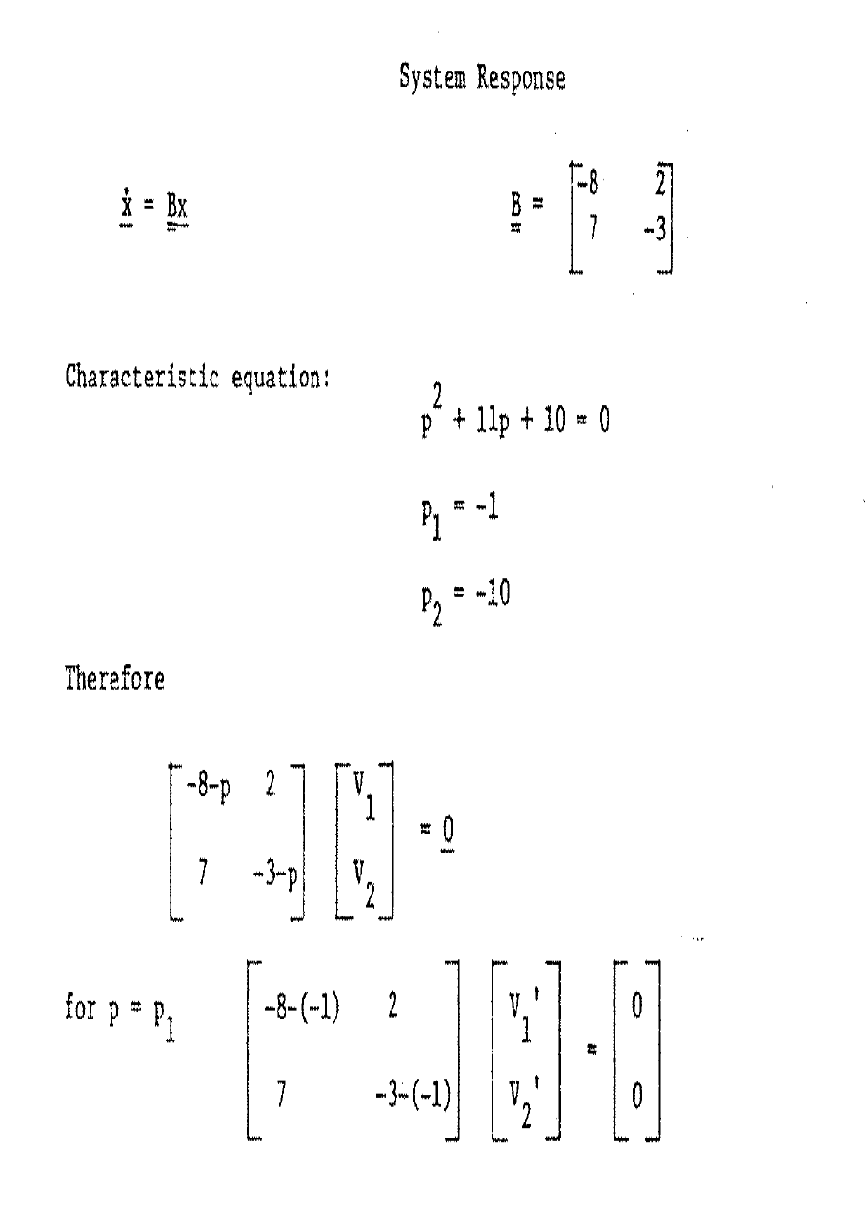

Slide 33
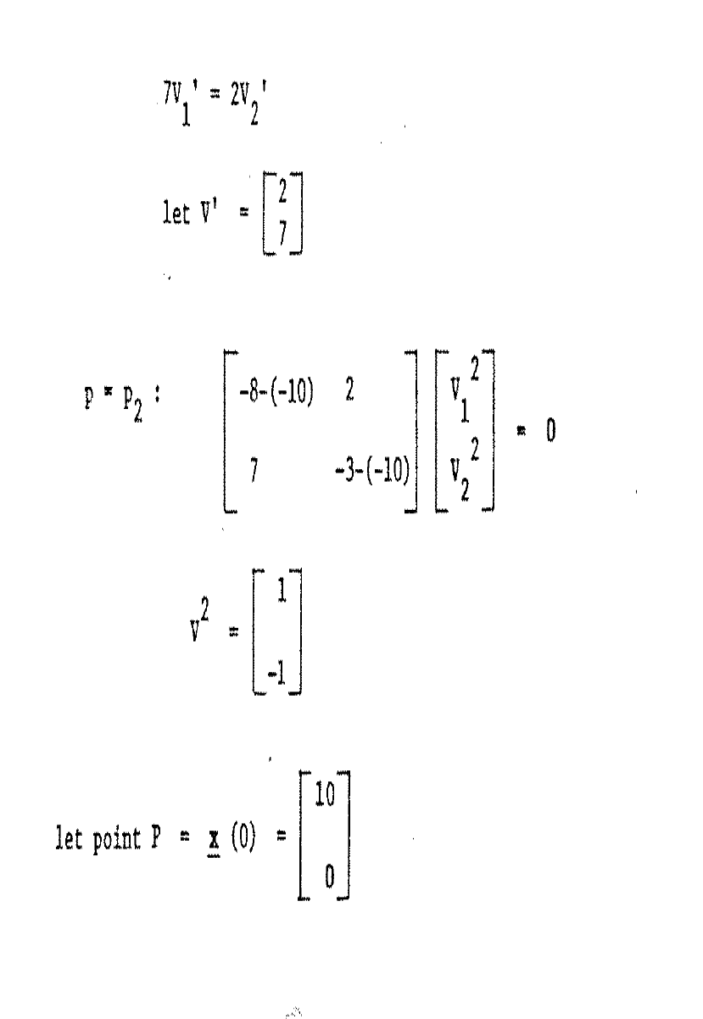

Slide 34
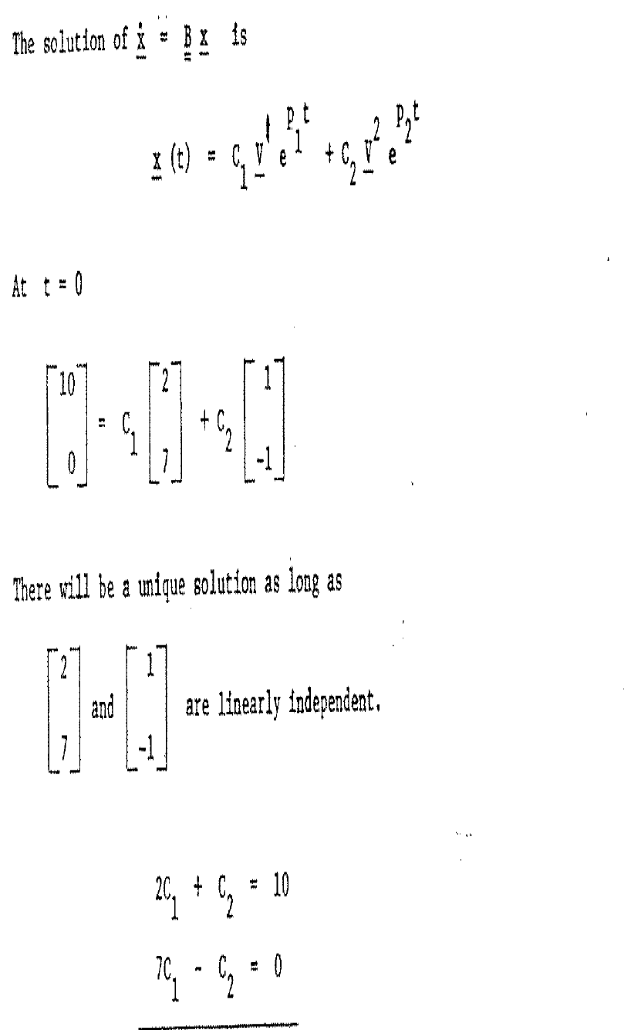

Slide 35
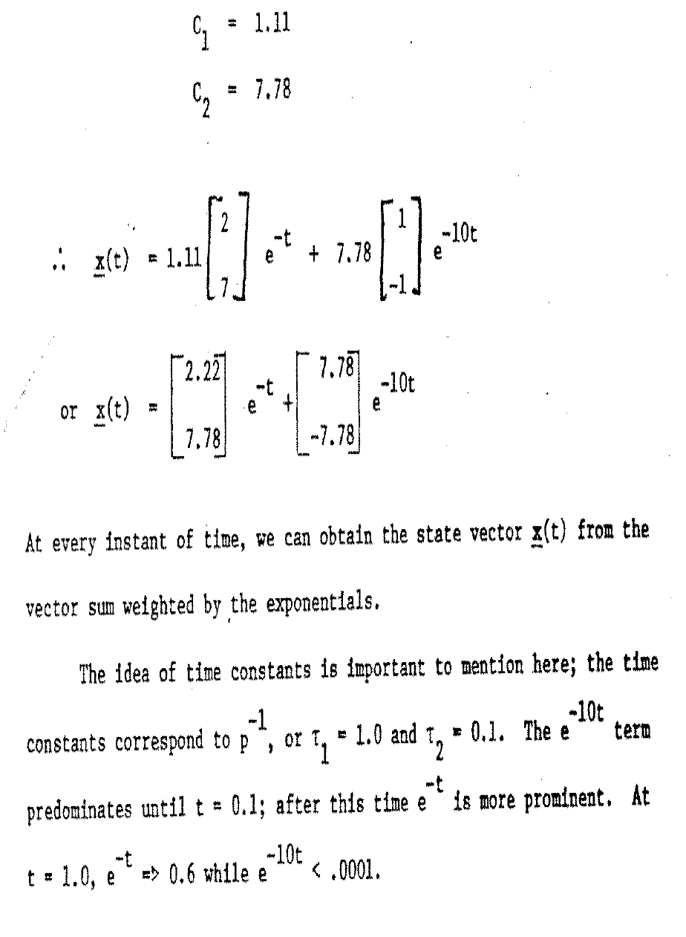

Slide 36
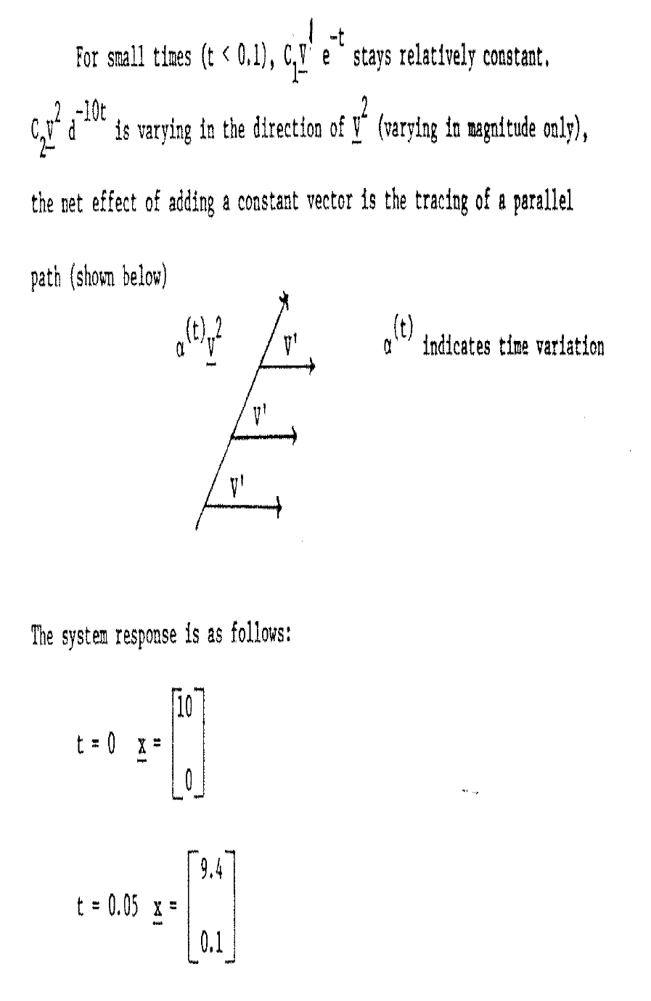

Slide 37
